Slide 1

Security Enhancement Of Openflow Networks

Slide 2
Table of contents
01
02
03
04
05
06
Introduction
Objectives
Implementation
Reachability test
Server/Client and p2p Communication
Web service
07
08
Trace route
Future work

Slide 3

01
Introduction

Slide 4
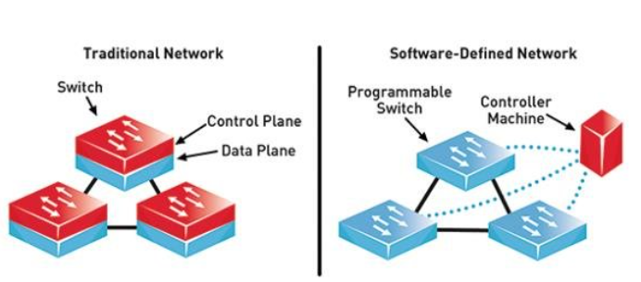
Introduction
With the increasing reliance on Software-Defined Networking (SDN) for its flexibility and programmability, the need for robust security mechanisms has become paramount. One of the major challenges facing SDN infrastructures is the susceptibility to Denial of Service (DoS) attacks.
When comparing Software-Defined Networking (SDN) with traditional networking approaches, several key differences emerge, impacting various aspects such as architecture, management, flexibility, scalability, and security.
So ,SDN is software-based, while traditional networking is hardware-based

Slide 5
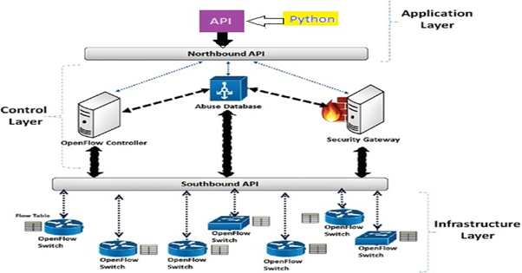
Why SDN ?
Security:
Traditional Networking: Security mechanisms are typically distributed across network devices, making it challenging to enforce consistent policies and detect threats effectively. Security updates and patches may be device-specific and require manual intervention.
SDN: SDN offers improved security through centralized policy enforcement and granular visibility. Security policies can be defined and enforced centrally, with the controller dynamically adapting to mitigate security threats. Additionally, SDN facilitates integration with security tools and analytics platforms for enhanced threat detection and response.

Slide 6
02
Objectives

Slide 7
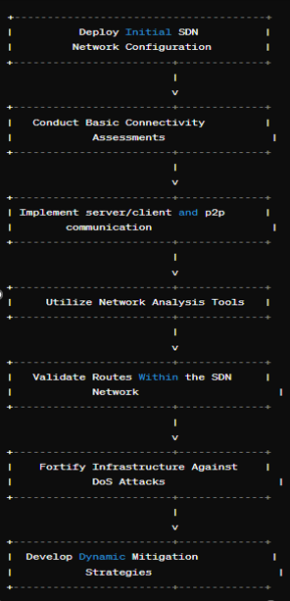
Deploy Initial SDN Network Configuration
Conduct Basic Connectivity Assessments
Implement server/client and p2p communication
Utilize Network Analysis Tools
Validate Routes Within the SDN Network
Fortify Infrastructure Against DoS Attacks
Develop Dynamic Mitigation Strategies

Slide 8
03
Implementation

Slide 9
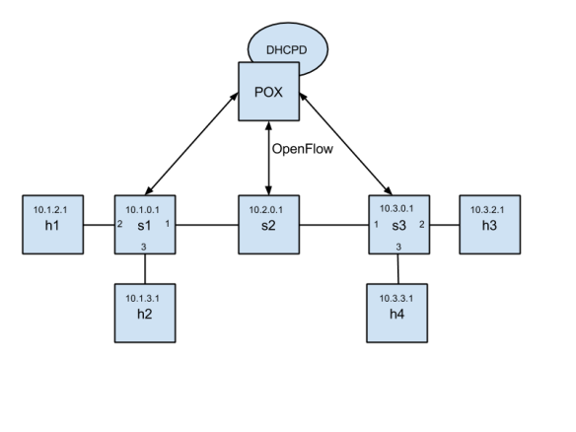
Mininet and pox controller
Open-Source and Customizability
Python-Based
Active Community and Documentation
Support for OpenFlow
OpenFlow and Python-based development

Slide 10
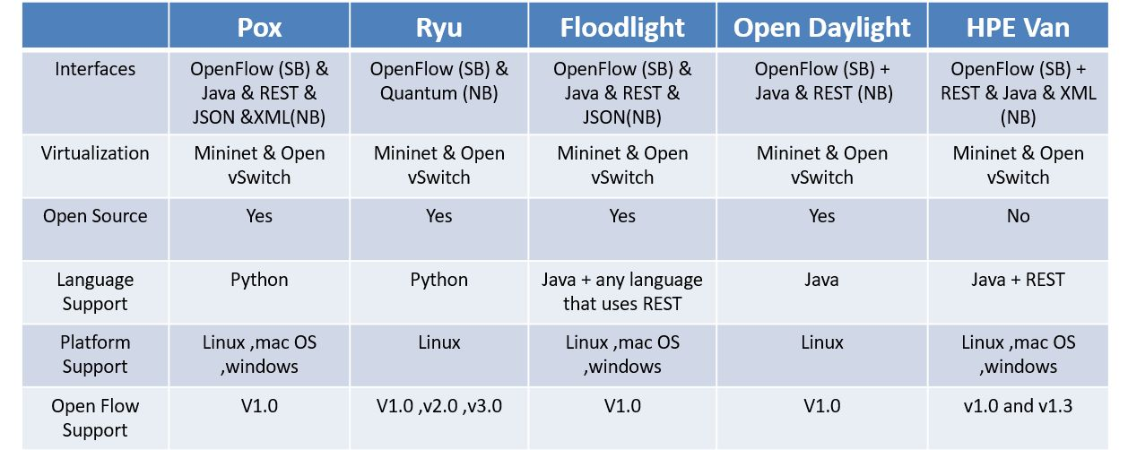
Why POX ?

Slide 11
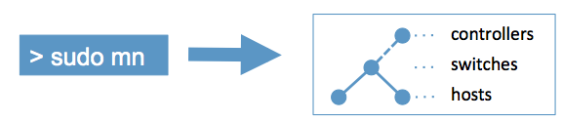
Mininet

Slide 12
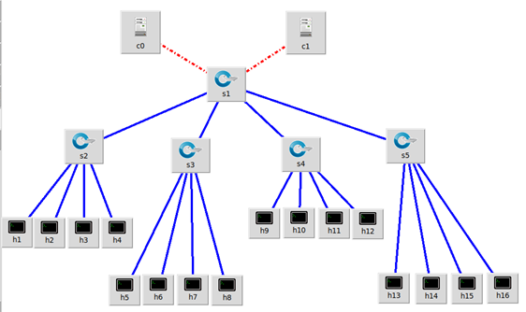
Our Topology
Our network architecture is characterized by a tree topology configuration. Within this framework, we have established two controllers operating on distinct ports, enhancing redundancy and fault tolerance within our network infrastructure.
Additionally, a core switch serves as the central node, facilitating efficient communication and traffic management among network components.
However, it is essential to recognize potential vulnerabilities inherent in this setup, particularly with regards to single points of failure and the implications thereof.

Slide 13
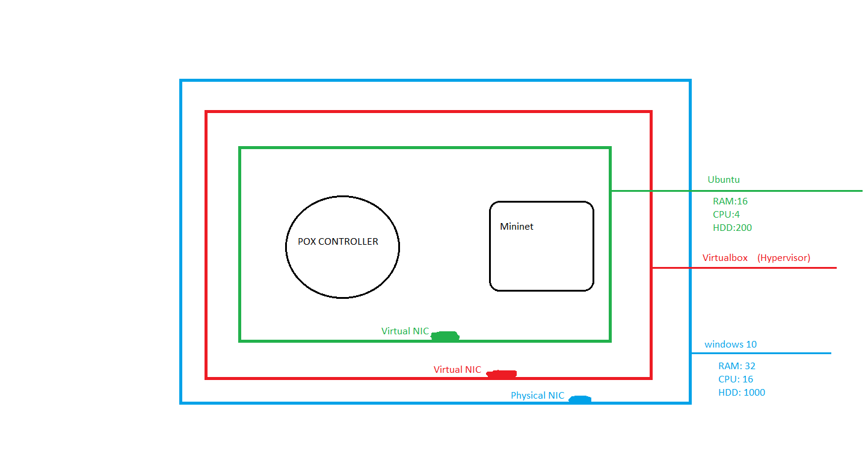
Components selected for the design

Slide 14
Implementing first topology
Command used for Mininet:
$ sudo mn --switch ovsk --topo tree,depth=2,fanout=8 -- controller=remote,port=6100
Command used for pox:
controllers 1(c0): $ ./pox.py openflow.of_01 --port=6100 forwarding.l2_pairs
This create : (1 pox controller – 9 OpenFlow switches – 64 pc device)

Slide 15
Two modifications
1- Reduce number of nodes in the network.
We decreased number of switches and hosts in the network to guarantee good performance
2- Add second controller.
to work as a data backup or a data replication, because availability of a controller is essential to guarantee the availability of network services.

Slide 16
Implementing second topology
Command used for Mininet:
$ sudo mn --switch ovsk --topo tree,depth=2,fanout=4 --controller remote,port=6100 --controller remote,port=6101
Commands used for pox:
controllers 1(c0): $ ./pox.py openflow.of_01 --port=6100 forwarding.l2_pairs
controllers 2(c1): $ ./pox.py openflow.of_01 --port=6101 forwarding.l2_pairs
This create : (2 pox controller – 5 OpenFlow switches – 16 pc device)

Slide 17
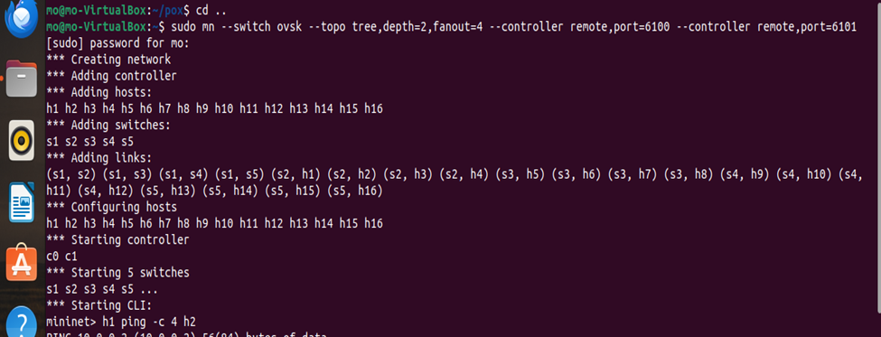
Creating the network

Slide 18
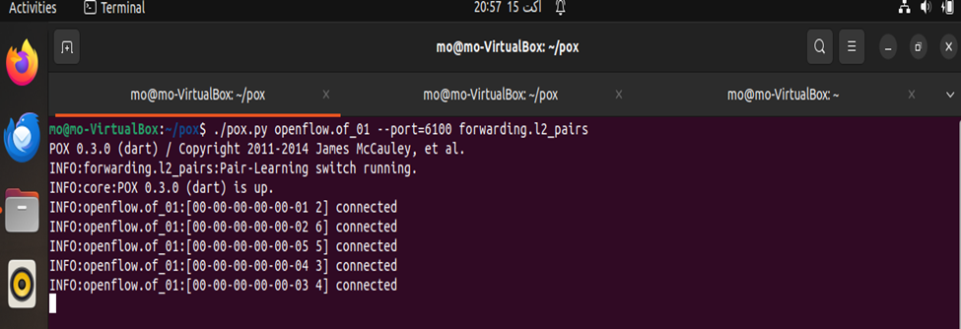
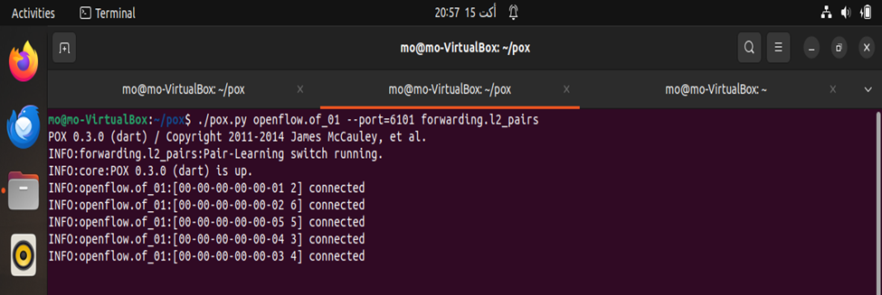
Controllers is up
C0 is up
C1 is up

Slide 19
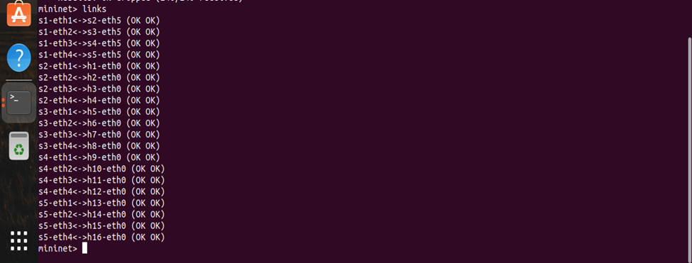
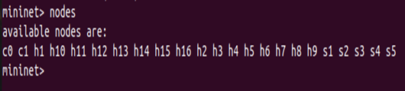
Nodes
Links

Slide 20
Tree topology

Slide 21
04
Reachability test

Slide 22
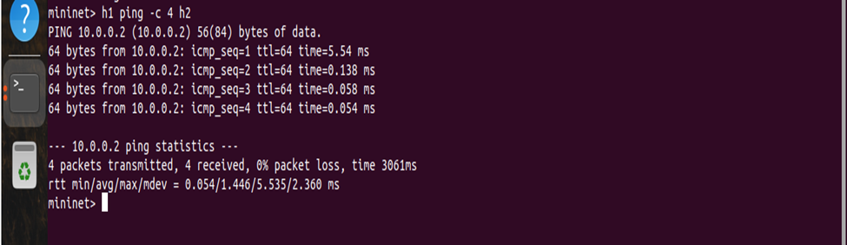
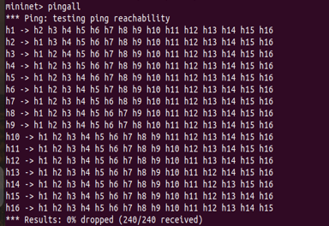
Ping command

Slide 23
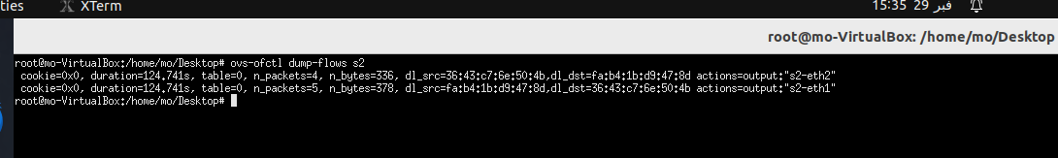
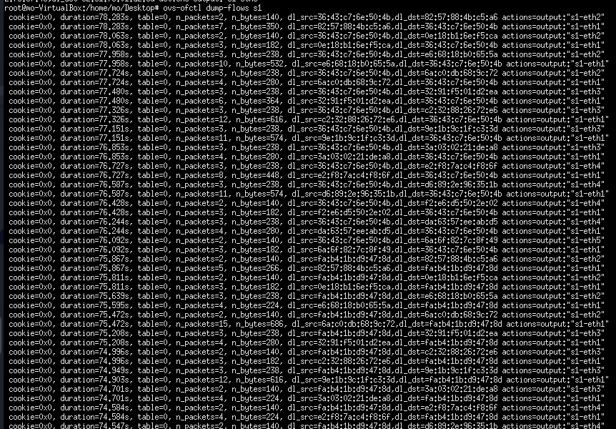
Flow rules
S2 flow rules after h1 ping on h2
S1 flow rules after pingall and there is more flow rules

Slide 24
05.1
Server/Client Communication

Slide 25

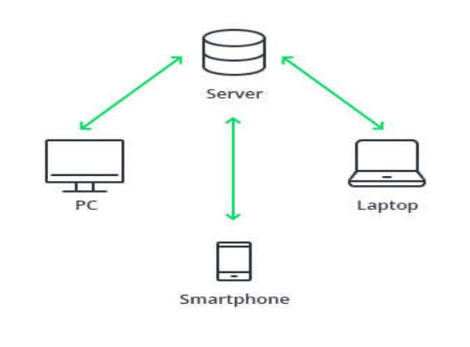
Server/Client Communication
Wing FTP Server Admin
It is a software solution used for transferring files across the internet using ftp protocol.
Overview
This server can do multiple things like
File Access
Server logs
Audit & Report
Graphs & activity

Slide 26

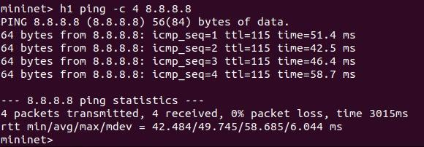
NAT Protocol
Running the nat protocol on network to make the hosts go online by giving them public ip addresses.
Also to communicate with the ftp server.
Ping on google’s DNS:

Slide 27
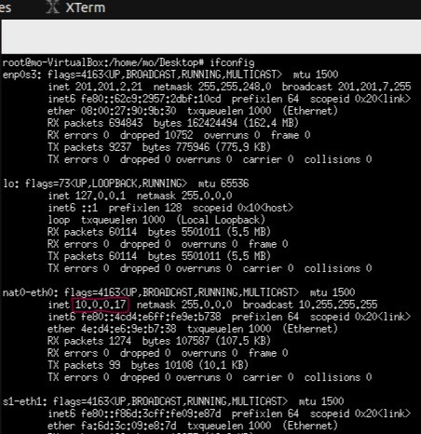
NAT Protocol
As we see all interfaces are defined on the nat0.
Also have an ip address 10.0.0.17

Slide 28
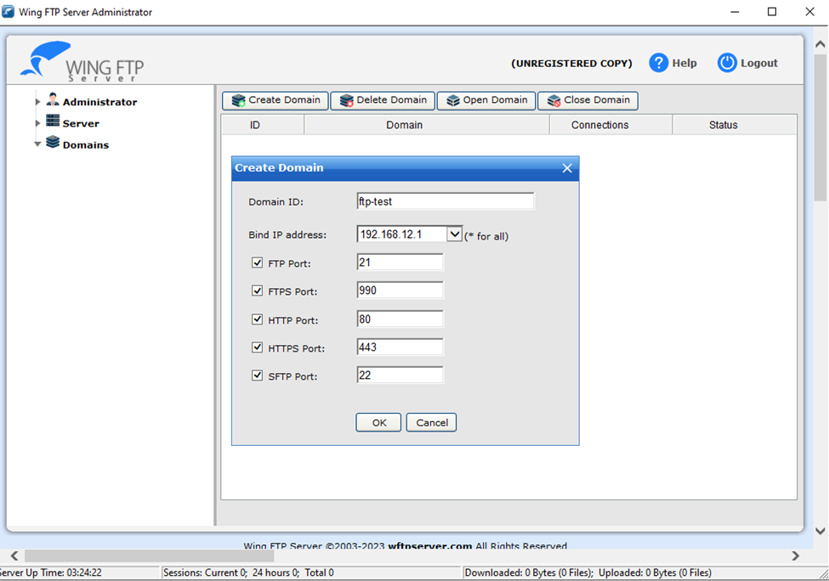
Configurations of the server
First ,create a domain and asigen an ip address to it.
Select the services.

Slide 29
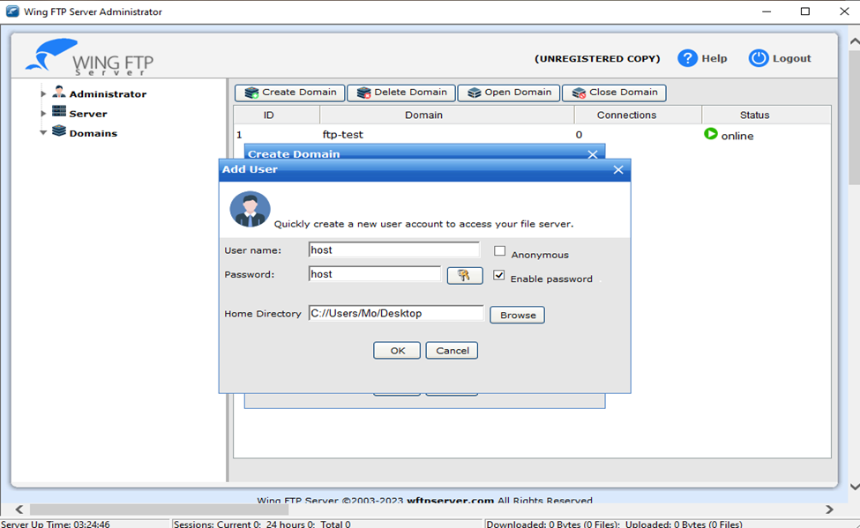
Configurations of the server
Secondly ,adding users ( submit the credentials ).
Select the directory of the files.

Slide 30
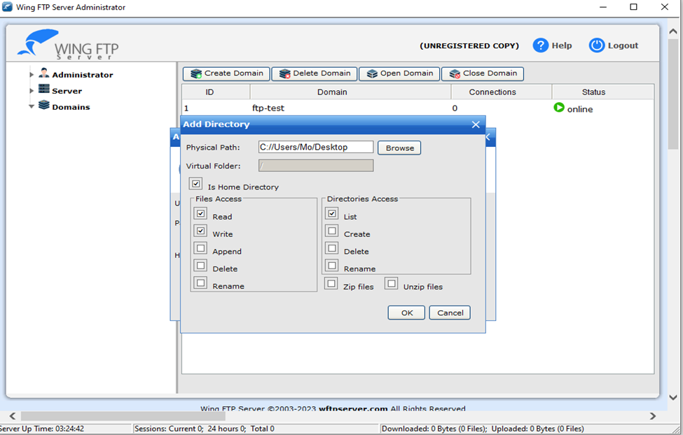
Configurations of the server
Select the file and directory access (assigning privileges).

Slide 31
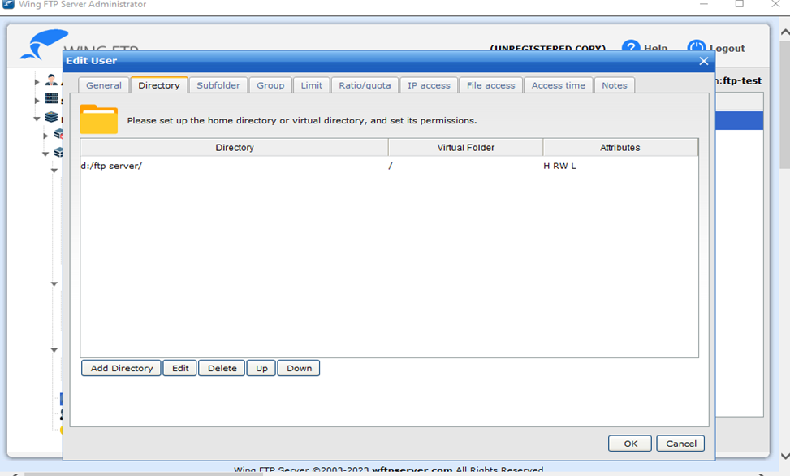
Configurations of the server
Edit the user directory to the desired folder which contains the files of the server.

Slide 32
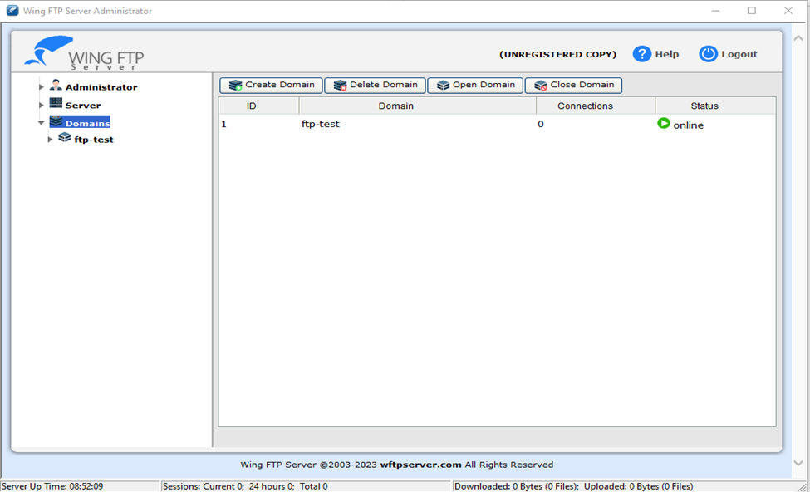
Configurations of the server
Finally, the domain is online.

Slide 33
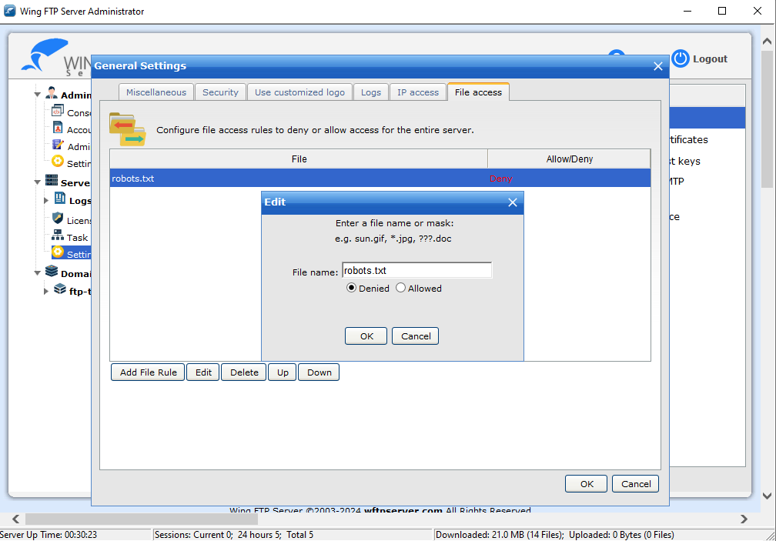
Configurations of the server
Adding some privileges on some files.

Slide 34
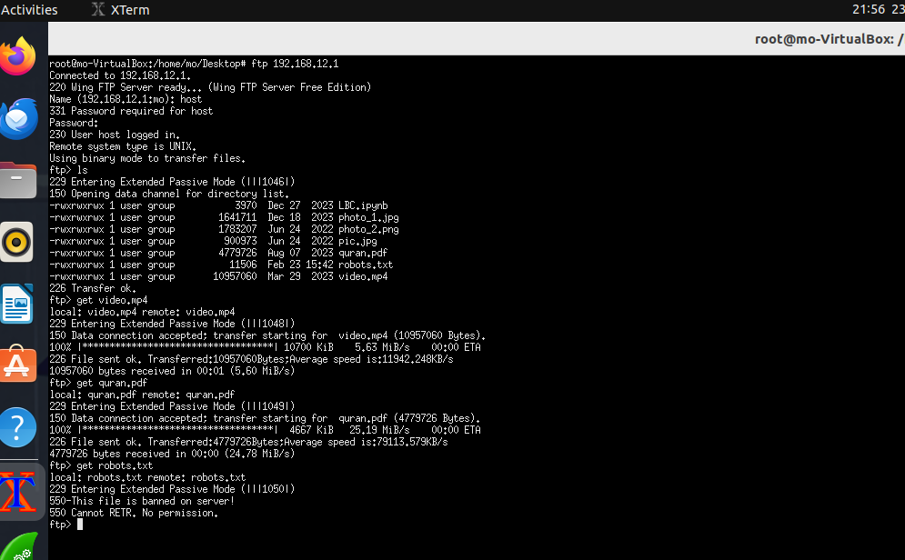
On SDN Network
From the CLI of h1.
Connect to the server by ip address.
Enter the credentials (username,password).
Ls command to see the files on the server.
Get (download)some files from the server.
Try to download the banned file.
1
2
3
4
5
6
7
8

Slide 35
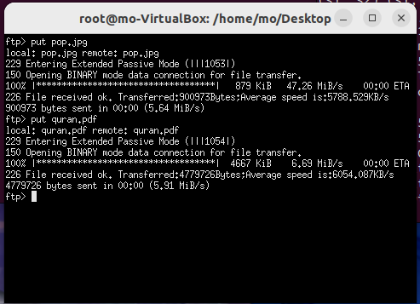
On SDN Network
Also if we want to upload some files to the server.

Slide 36
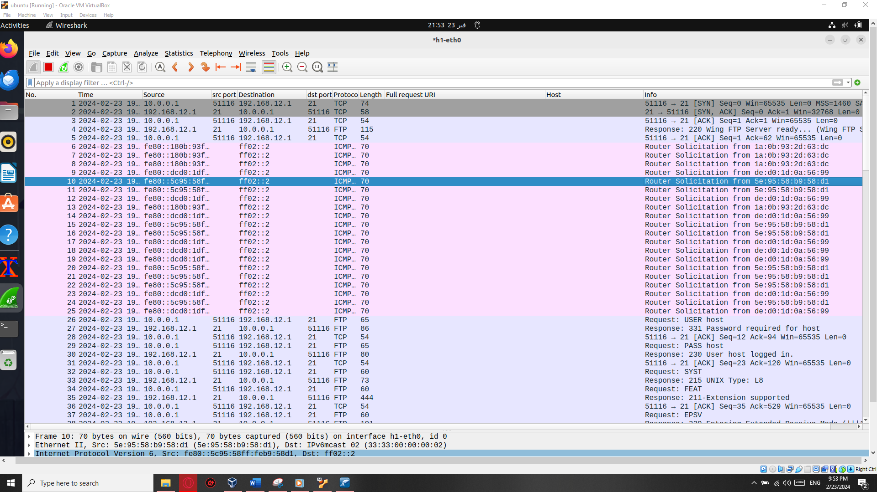
Capturing the packets using WireShark
TCP uses a three-way handshake to establish a reliable connection and Authentication between the host and the server.
After that the process of transferring files starts using ftp protocol.

Slide 37
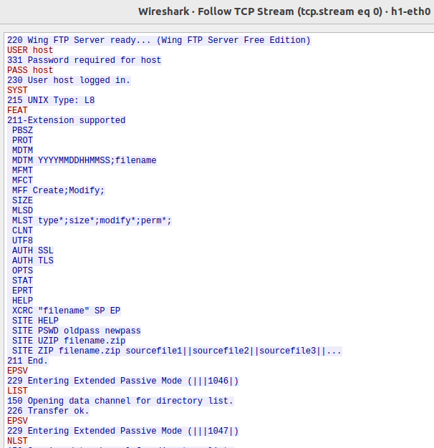
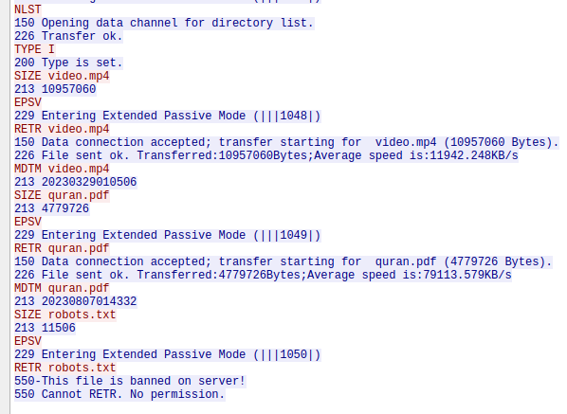
Capturing the packets using WireShark
If we follow the tcp stream we’ll see all the data (traffic) as a plaintext because ftp protocol is not secure.

Slide 38
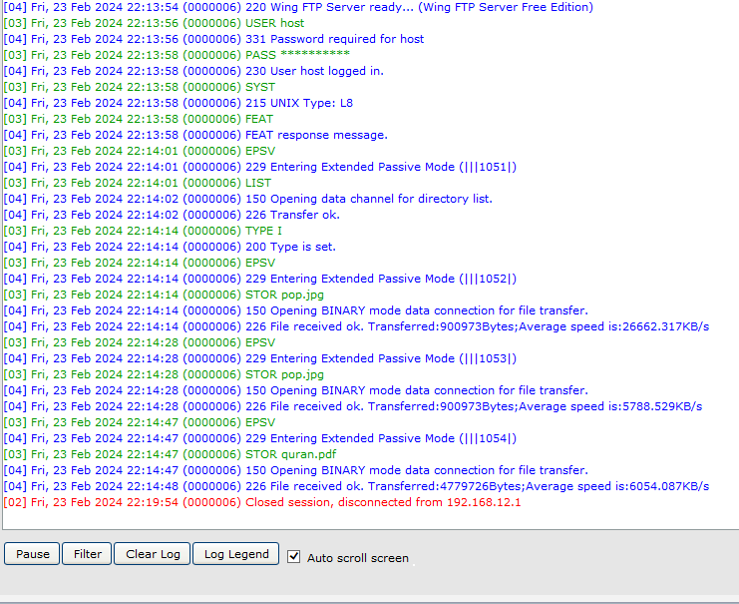
Logs & Status
Domain log saved in the server.
Also all sessions.
Ex: the last uploaded files to the server.

Slide 39
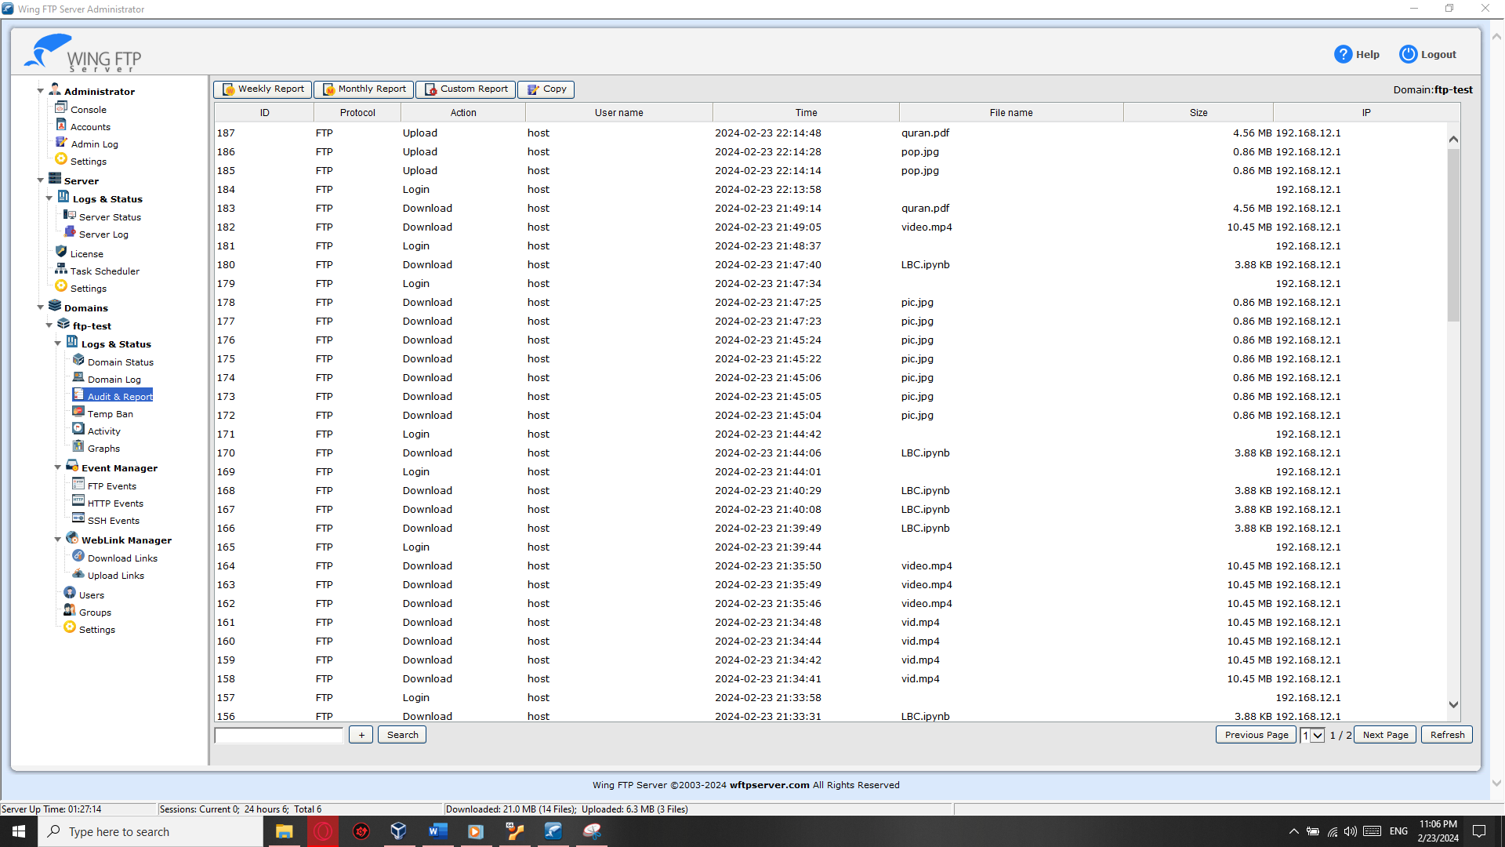
Logs & Status
Audit & Reports also saved in the server.
Includes (ID,protocol,Action,username,time,file name,size and server ip address)

Slide 40
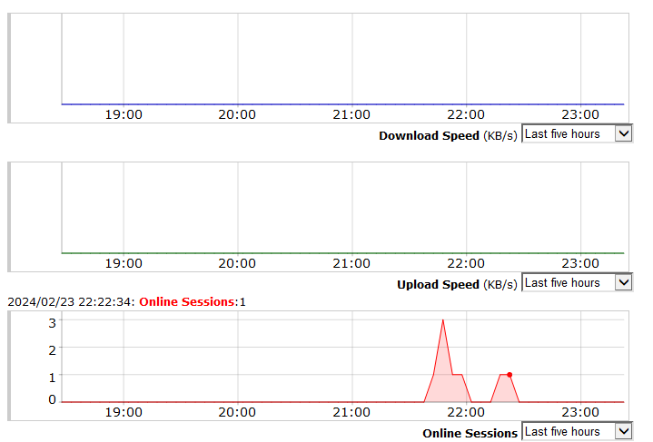
Logs & Status
Graphs shows the number of online sessions ,the download and upload speed.

Slide 41
05.2
Peer To Peer Communication

Slide 42
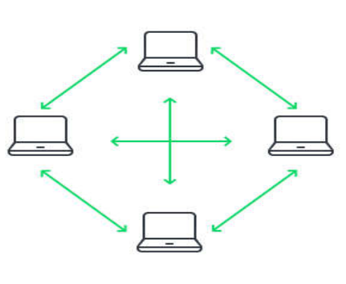
Peer To Peer Communication
p2p
Both peers exchange information with each other without the need for any intermediate servers.
Netcat tool
Nc is a powerful and versatile networking utility tool used for reading from and writing to network connections.
It provides a simple and straightforward way to create TCP/IP connections, listen for incoming connections, transfer data, and perform various network-related tasks.

Slide 43
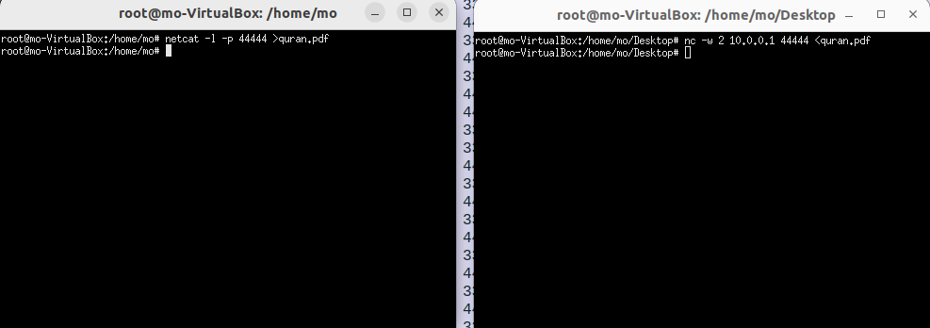
h1 is listening for an incoming connections
h16 send the file

Slide 44
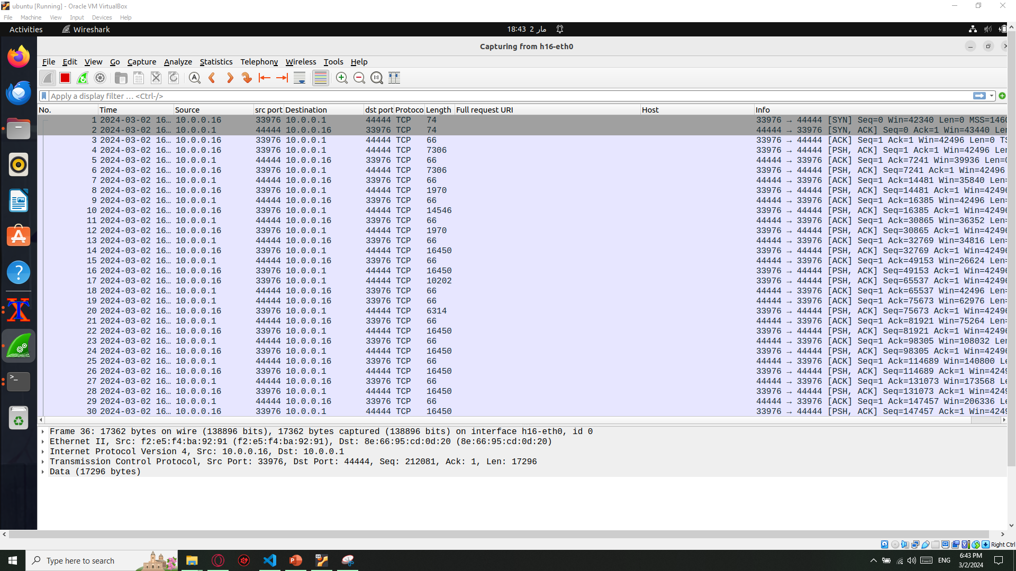
wireshark
The start of the connection

Slide 45
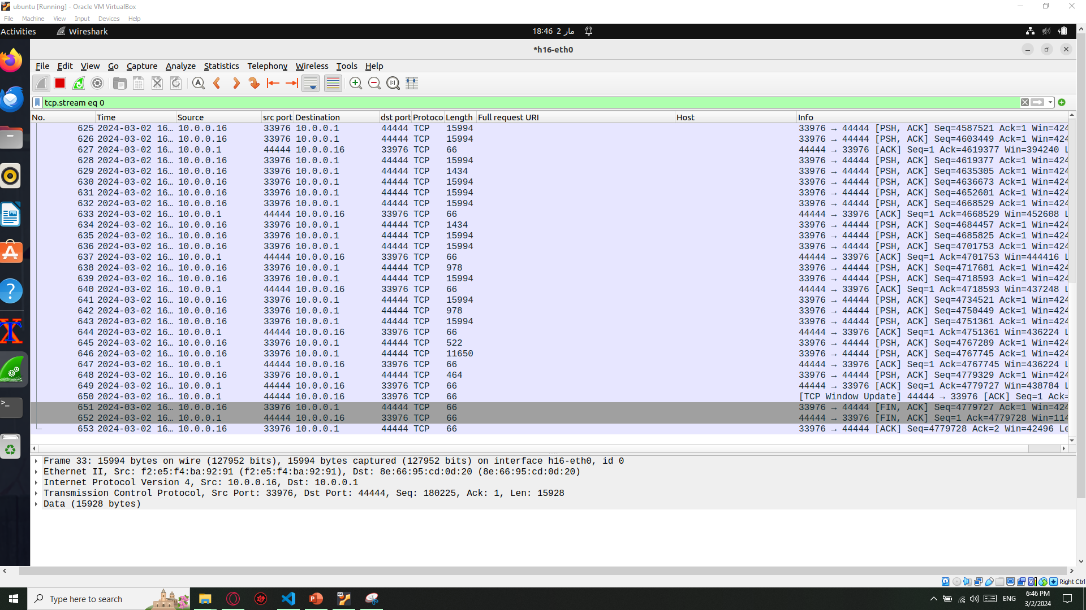
wireshark
The end of the connection and file transferred successfully

Slide 46
06
Web service

Slide 47
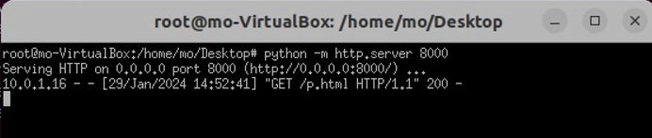
HTTP Server
What is http server ?
Implementation of http server

Slide 48
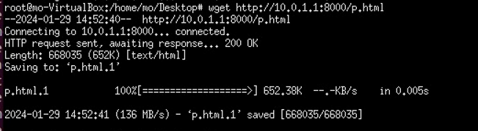
HTTP Server
Access the http server from another host
Let’s breakdown the command
Wget http://10.0.1.1:8000/p.html

Slide 49
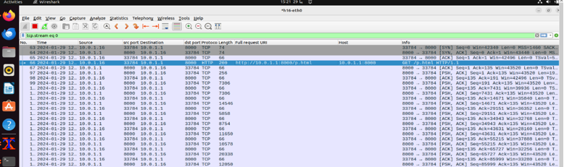
HTTP Server
Packet capture :
Notice the first 3 packets

Slide 50
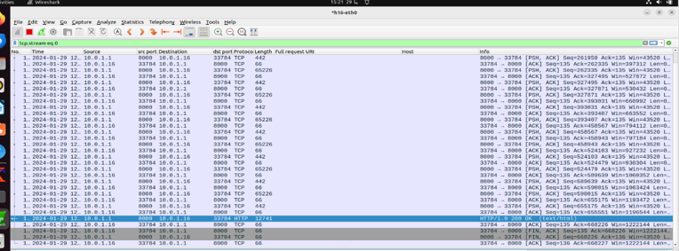
HTTP Server
Packet capture
Notice the last 3 packets

Slide 51
07
traceroute

Slide 52
traceroute
What is traceroute ? why we use traceroute ?
Installation of traceroute

Slide 53
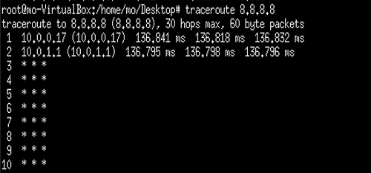
traceroute
Problem faced

Slide 54
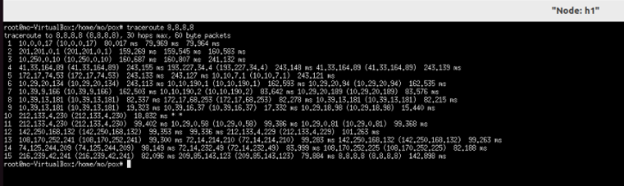
traceroute
How we solve the problem ?

Slide 55
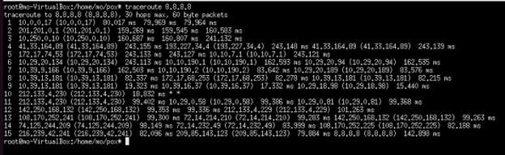
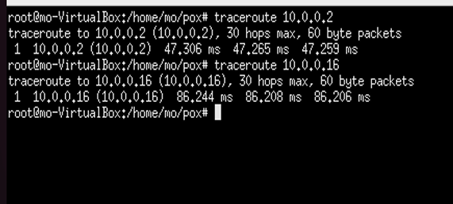
traceroute
Tool usage

Slide 56
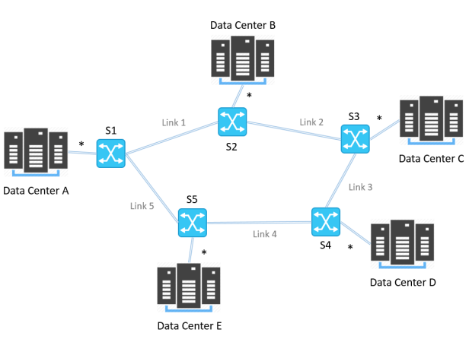
Route validation
1)What is the meaning of route validation ?
2)What are attributes and Techniques used to validate open flow packets through network?
3)Verify best path (route ) through network?

Slide 57
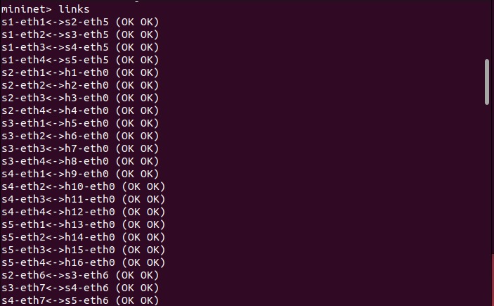
Bandwidth
Bandwidth utilization refers to the amount of network capacity being consumed by traffic flows on specific routes or links within the network. Monitoring bandwidth utilization helps in ensuring that.
Bw=total data transferred (inbits)/capture duration
We need First to add links between End switches
py net.addLink(s2,s3)
py net.addLink(s3,s4)
py net.addLink(s4,s5)

Slide 58
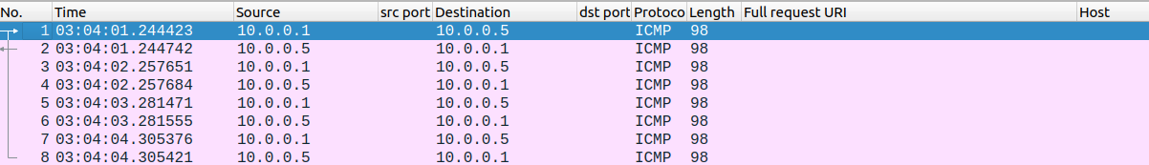
capturing Using Wireshark.
What we observed repeating the test through different Destinations?
Why Should we Customize our network ?
s2-eth1<->h1-eth0…bw=98*8*8bits/(32-29)sec
s1-eth2<->s3-eth5…bw=98*8*8bits/(27-24)sec
s1-eth1<->s2-eth5…bw=98*8*8bits/(22-19)sec

Slide 59
08
Future work

Slide 60
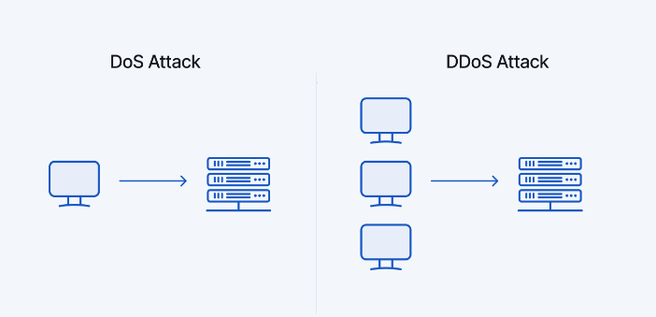
Work in progress : DOS Attack
Customize network to achieve SOP ( Singlepoint of fauilre concept)?
What is DOS attack ? what is DDOS attack ?
how could it be done ?

Slide 61
THANKS !

